Slide 1

Ensuring More Accurate, Generalisable, and Interpretable Machine Learning Models for Bioinformatics
Wandrille Duchemin, Van Du, Markus Müller
Swiss Institute of Bioinformatics

Slide 2
Outline
Markus Müller
Intermediate machine learning (ML)
Trees
Bagging and boosting
Classification and regression with XGBoost
Hyperparameter optimization with Hyperopt
Nested cross-validation
Interpretable machine learning with LIME and SHAP

Slide 3
Intermediate ML
Sklearn
SVM,KNN, LR, RF, GridSearch
XGBoost
LightGBM
CatBoost HyperOpt
TensorFlow
PyTorch
<
<
Complexity

Slide 4
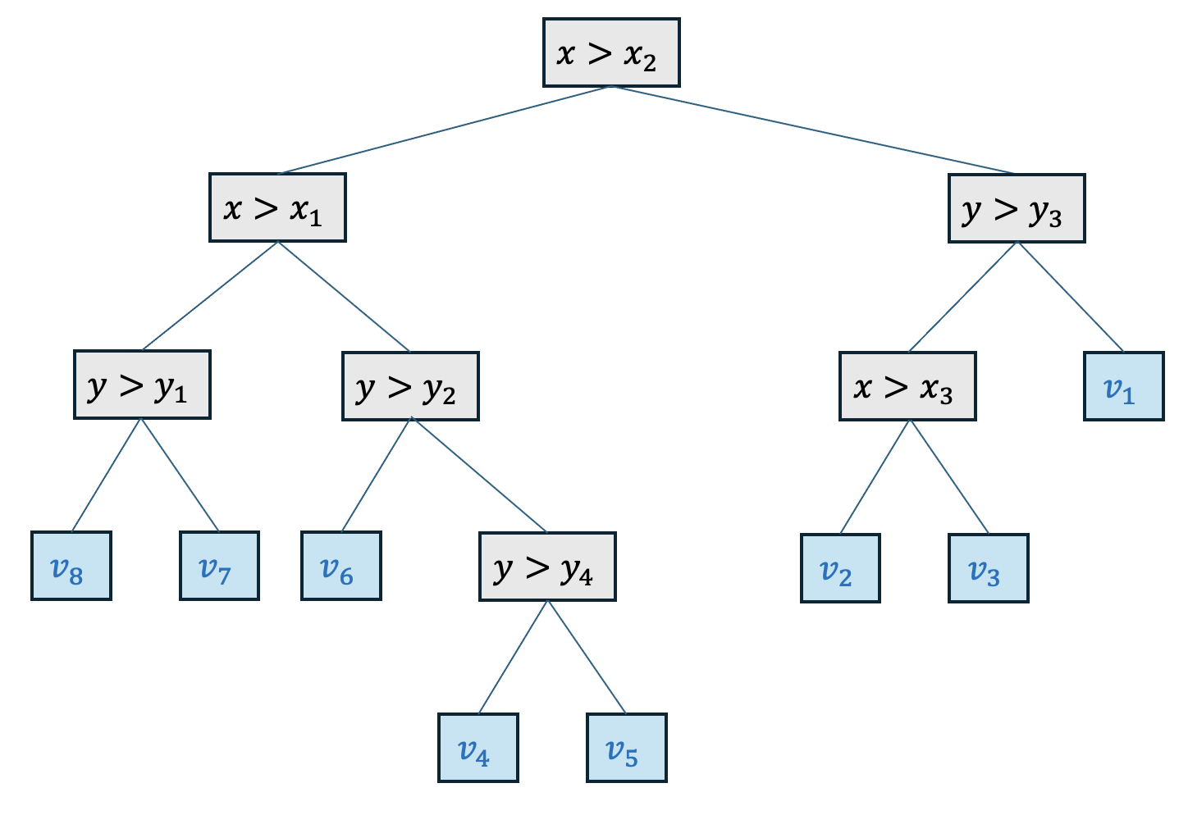

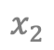
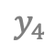

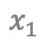
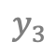
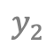
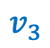
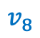
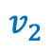
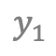
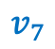
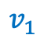
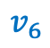
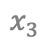
Trees
Markus Müller
$$v_{5}$$
$$y_{4}$$
$$v_{1}$$
$$y_{3}$$
$$v_{7}$$
$$v_{4}$$
depth
$$y_{2}$$
$$v_{2}$$
$$v_{3}$$
$$y_{1}$$
$$v_{8}$$
$$v_{6}$$
$$x_{1}$$
$$x_{2}$$
$$x_{3}$$
Leave nodes

Slide 5
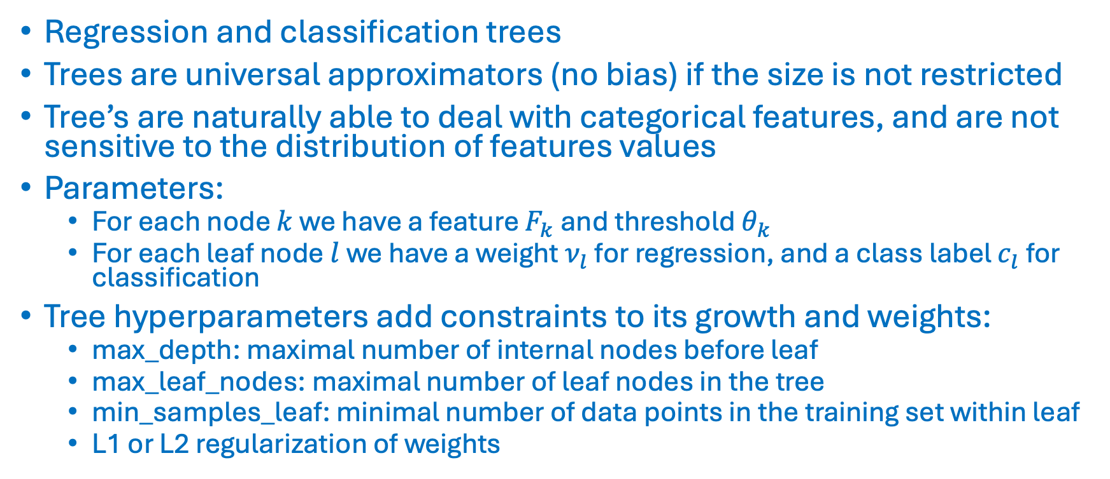
Trees
Markus Müller
Regression and classification trees
Trees are universal approximators (no bias) if the size is not restricted
Tree’s are naturally able to deal with categorical features, and are not sensitive to the distribution of features values
Parameters:
For each node $k$ we have a feature $F_{k}$ and threshold $θ_{k}$
For each leaf node $l$ we have a weight $ν_{l}$ for regression, and a class label $c_{l}$ for classification
Tree hyperparameters add constraints to its growth and weights:
max_depth: maximal number of internal nodes before leaf
max_leaf_nodes: maximal number of leaf nodes in the tree
min_samples_leaf: minimal number of data points in the training set within leaf
L1 or L2 regularization of weights

Slide 6
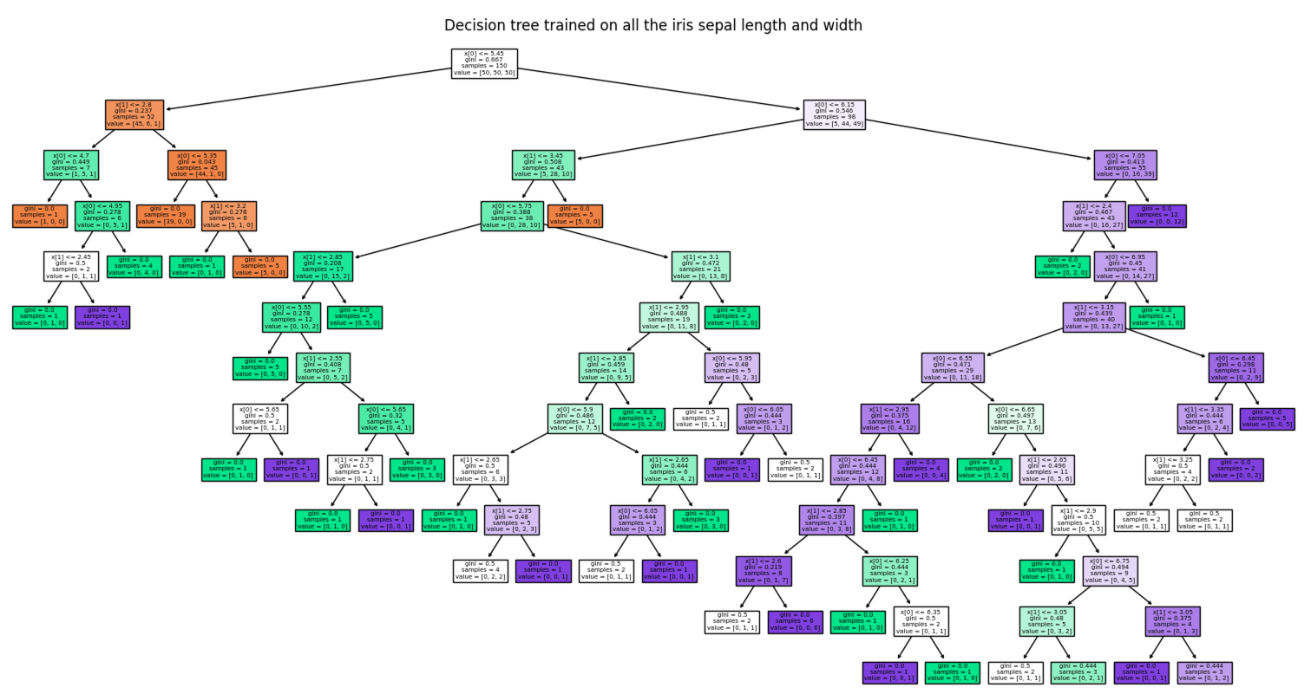
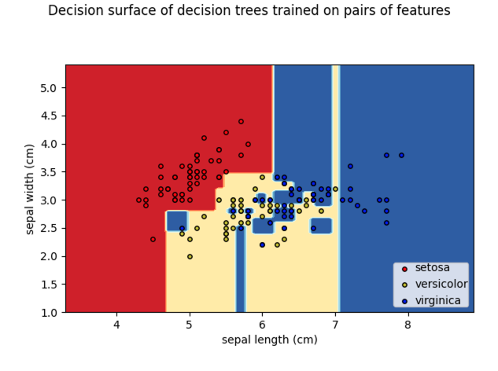
Trees
Markus Müller
Code on sklearn page !

Slide 7
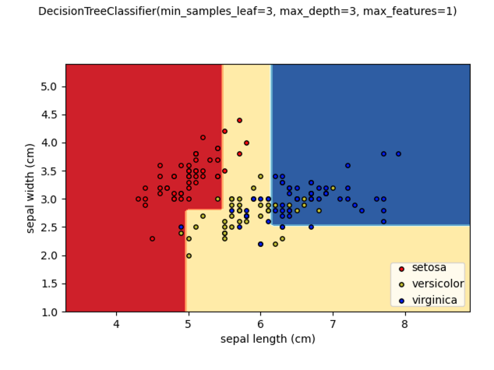
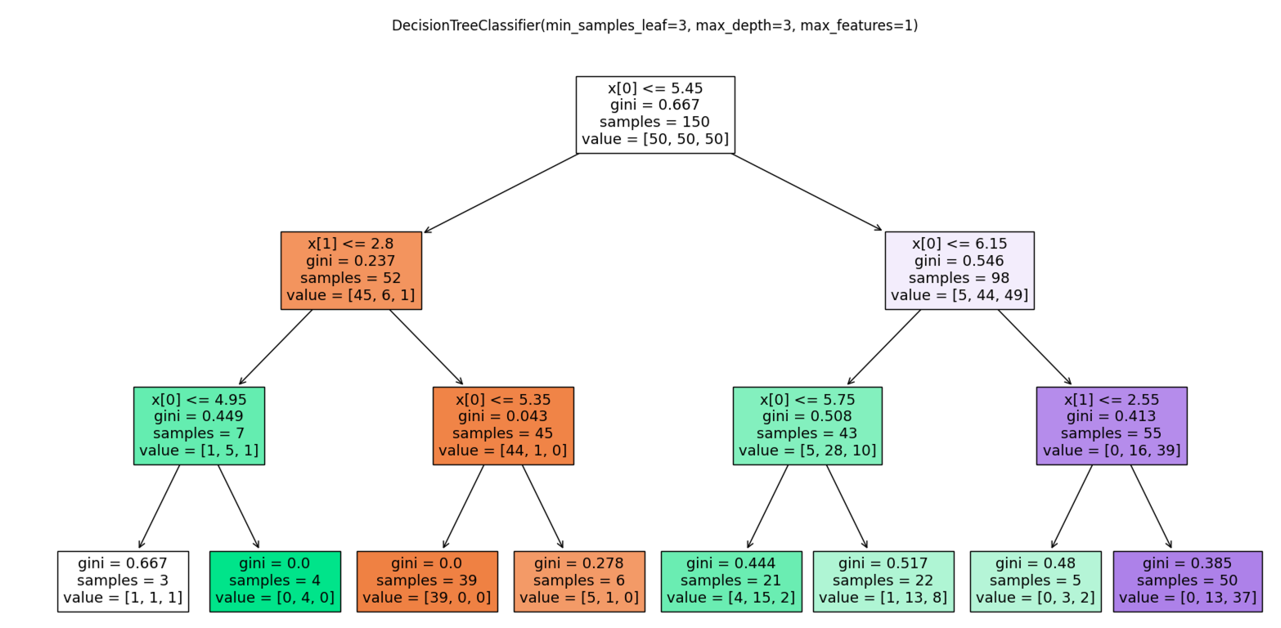
Tree hyperparameters
Markus Müller

Slide 8
Bias and Variance
Markus Müller
The bias error is an error that occurs if the assumptions in the learning algorithm do not match the data. High bias can cause an algorithm to misclassify a significant number of data items (underfitting). The bias does not disappear if you increase the size of your training data.
The variance is an error from sensitivity of the algorithms to small fluctuations in the training set. High variance may result from an algorithm modeling the noise in the training data (overfitting). The variance becomes smaller if we increase the size of your training data.
Notes:
.

Slide 9
Bias and Variance
Markus Müller
(Model prediction error)² = (Model bias error)² + (Model variance) + (Data variance)
More flexible models
Boosting
More data
Bagging
Boosting

Slide 10
Bagging and Boosting
Markus Müller
Obtain a good classifier by combining many basic, weak classifiers with limited amount of data
Weak classifiers have either a high bias and/or high variance
Weak classifiers are for example linear classifiers (high bias for non-linear problems) or tree classifiers (high variance without pruning)
Weak classifiers have to be better than random labels

Slide 11
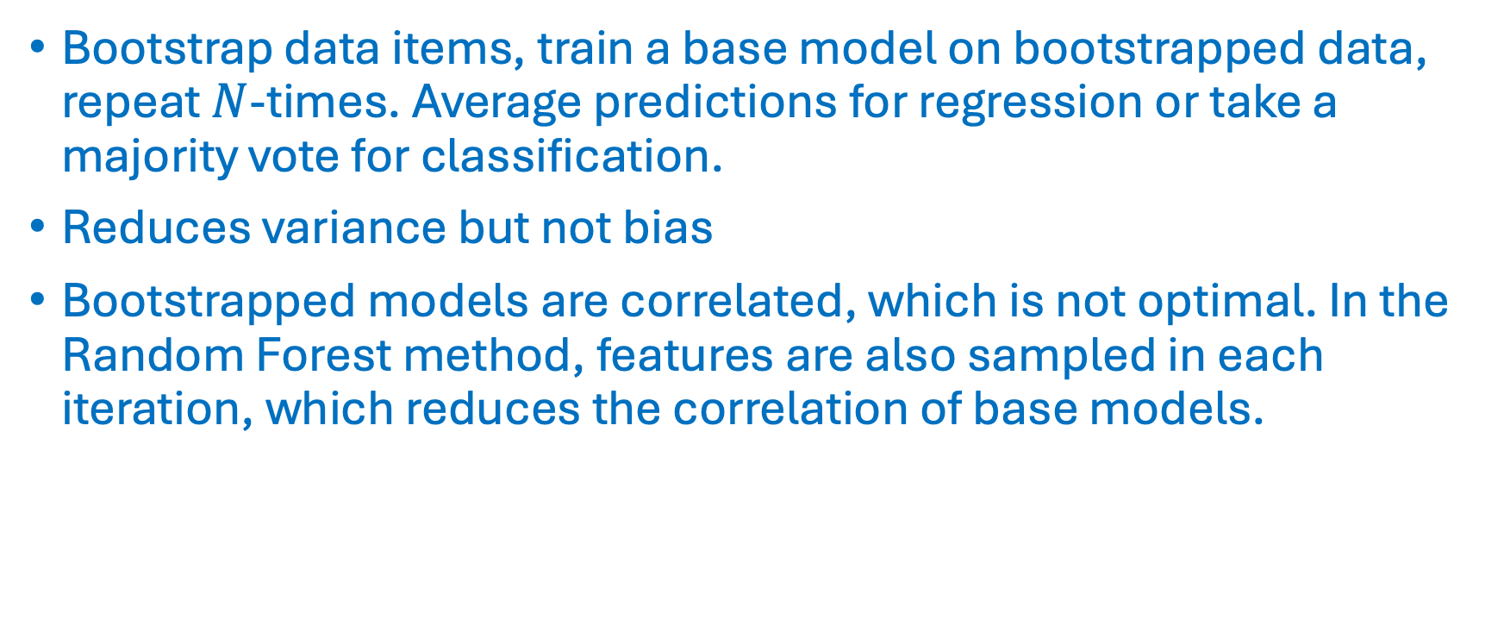
Bagging
Markus Müller
Bootstrap data items, train a base model on bootstrapped data, repeat $N$-times. Average predictions for regression or take a majority vote for classification.
Reduces variance but not bias
Bootstrapped models are correlated, which is not optimal. In the Random Forest method, features are also sampled in each iteration, which reduces the correlation of base models.

Slide 12
Boosting
Markus Müller
In each iteration, the boosting method tries to correct the error of the previous iteration by focusing on the wrongly predicted data items.
The current base model corrects those misclassified data points and is added to the previous models with a weight that is inversely proportional to its error.
The boosting method can correct the bias of the base classifier.
AdaBoost implements the boosting algorithm for classification and regression.
Gradient boosting is a more general framework that includes boosting algorithms.

Slide 13
XGBoost: a scalable and flexible gradient boosting system
Markus Müller
Extreme gradient boosting system
Introduced by Chen & Guestrin in 2016 (Chen & Guestrin, KDD 16, 2016)
Efficient implementation for tree and linear boosting for regression, classification, and ranking.
Support for parallelization, cluster computing, and GPU.
Very flexible and configurable API.
Callbacks, checkpoints, early stopping, dropout (dart), incremental learning, configurable sampling, regularization, many losses and metrics, choice of algorithm, …
XGBoost provides robust and complementary results when compared to neural network models on tabular data

Slide 14
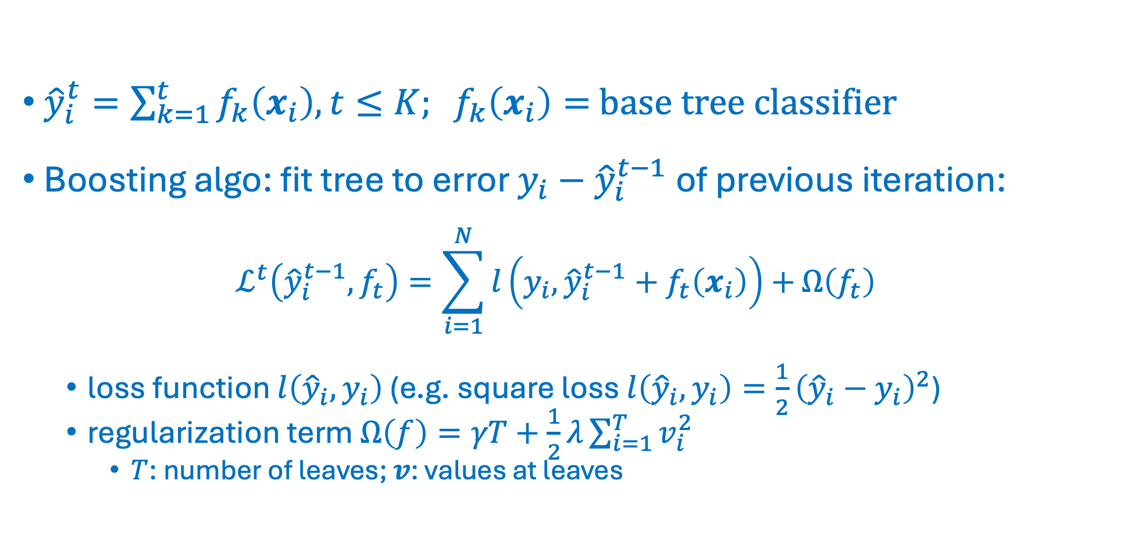
XGBoost
Markus Müller
${\hat{y}}_{i}^{t}=\sum_{k=1}^{t}{f_{k}\left(x_{i}\right),t≤K; f_{k}\left(x_{i}\right)=}$ base tree classifier
Boosting algo: fit tree to error $y_{i}−{\hat{y}}_{i}^{t−1}$of previous iteration:
$$ℒ^{t}\left({\hat{y}}_{i}^{t−1},f_{t}\right)=\sum_{i=1}^{N}{l\left(y_{i},{\hat{y}}_{i}^{t−1}+f_{t}\left(x_{i}\right)\right)+}Ω\left(f_{t}\right)$$
loss function $l\left({\hat{y}}_{i},y_{i}\right)$ (e.g. square loss $l\left({\hat{y}}_{i},y_{i}\right)=\frac{1}{2}{\left({\hat{y}}_{i}−y_{i}\right)}^{2}$)
regularization term $Ω\left(f\right)=γT+\frac{1}{2}λ\sum_{i=1}^{T}{v_{i}^{2}}$
$T$: number of leaves; $v$: values at leaves

Slide 15
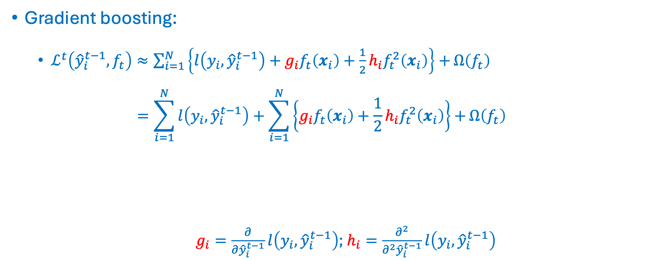
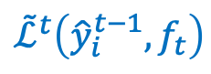
XGBoost
Markus Müller
Gradient boosting:
$ℒ^{t}\left({\hat{y}}_{i}^{t−1},f_{t}\right)≈\sum_{i=1}^{N}{\left\{l\left(y_{i},{\hat{y}}_{i}^{t−1}\right)+g_{i}f_{t}\left(x_{i}\right)+\frac{1}{2}h_{i}f_{t}^{2}\left(x_{i}\right)\right\}+}Ω\left(f_{t}\right)$ $=\sum_{i=1}^{N}{l\left(y_{i},{\hat{y}}_{i}^{t−1}\right)+\sum_{i=1}^{N}{\left\{g_{i}f_{t}\left(x_{i}\right)+\frac{1}{2}h_{i}f_{t}^{2}\left(x_{i}\right)\right\}}+}Ω\left(f_{t}\right)$
$g_{i}=\frac{∂}{∂{\hat{y}}_{i}^{t−1}}l\left(y_{i},{\hat{y}}_{i}^{t−1}\right)$; $h_{i}=\frac{∂^{2}}{∂^{2}{\hat{y}}_{i}^{t−1}}l\left(y_{i},{\hat{y}}_{i}^{t−1}\right)$
$${\tilde{ℒ}}^{t}\left({{\hat{y}}_{i}^{t−1},f}_{t}\right)$$

Slide 16
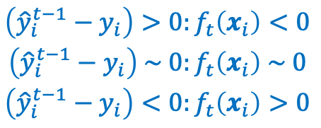
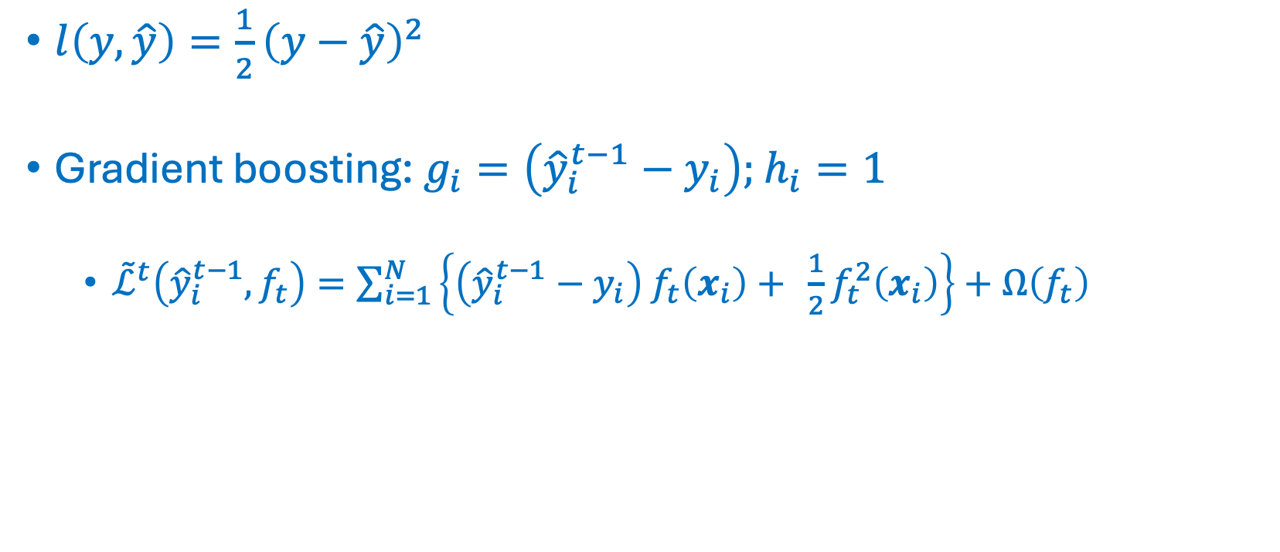
XGBoost - square loss
Markus Müller
$l\left(y,\hat{y}\right)={\frac{1}{2}\left(y−\hat{y}\right)}^{2}$
Gradient boosting: $g_{i}=\left({\hat{y}}_{i}^{t−1}−y_{i}\right);$ $h_{i}=1$
${\tilde{ℒ}}^{t}\left({{\hat{y}}_{i}^{t−1},f}_{t}\right)=\sum_{i=1}^{N}{\left\{\left({\hat{y}}_{i}^{t−1}−y_{i}\right) f_{t}\left(x_{i}\right)+ {\frac{1}{2}f}_{t}^{2}\left(x_{i}\right)\right\}+Ω\left(f_{t}\right)}$
$$\begin{matrix}\left({\hat{y}}_{i}^{t−1}−y_{i}\right)>0:f_{t}\left(x_{i}\right)<0 \\ \left({\hat{y}}_{i}^{t−1}−y_{i}\right) \sim 0:f_{t}\left(x_{i}\right) \sim 0 \\ \left({\hat{y}}_{i}^{t−1}−y_{i}\right)<0:f_{t}\left(x_{i}\right)>0\end{matrix}$$
Regularization term

Slide 17
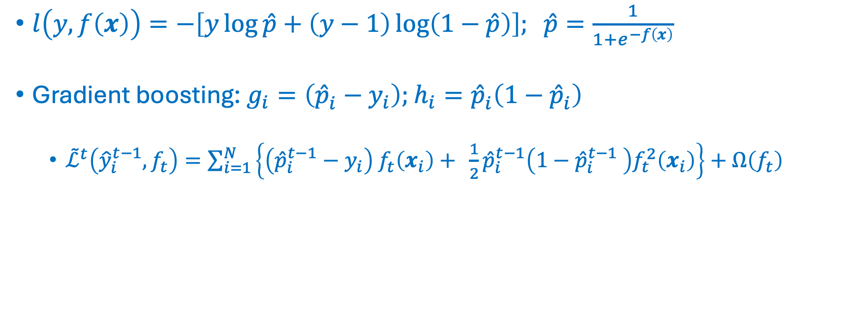

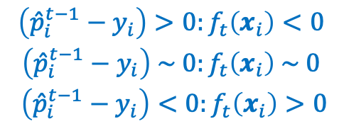
XGBoost - n$egative log likelyhood$
Markus Müller
$l\left(y,f\left(x\right)\right)=−\left[y\log{\hat{p}}+\left(y−1\right)\log\left(1−\hat{p}\right)\right]; \hat{p}=\frac{1}{1+e^{−f\left(x\right)}}$
Gradient boosting: $g_{i}=\left({\hat{p}}_{i}^{ }−y_{i}\right);$ $h_{i}={\hat{p}}_{i}^{ }\left({1−\hat{p}}_{i}^{ }\right)$
${\tilde{ℒ}}^{t}\left({\hat{y}}_{i}^{t−1},f_{t}\right)=\sum_{i=1}^{N}{\left\{\left({\hat{p}}_{i}^{t−1}−y_{i}\right) f_{t}\left(x_{i}\right)+ {\frac{1}{2}{\hat{p}}_{i}^{t−1}\left({1−{\hat{p}}_{i}^{t−1}}_{ }^{ }\right)f}_{t}^{2}\left(x_{i}\right)\right\}+Ω\left(f_{t}\right)}$
$$\begin{matrix}\left({\hat{p}}_{i}^{t−1}−y_{i}\right)>0:f_{t}\left(x_{i}\right)<0 \\ \left({\hat{p}}_{i}^{t−1}−y_{i}\right) \sim 0:f_{t}\left(x_{i}\right) \sim 0 \\ \left({\hat{p}}_{i}^{t−1}−y_{i}\right)<0:f_{t}\left(x_{i}\right)>0\end{matrix}$$
Regularization term

Slide 18
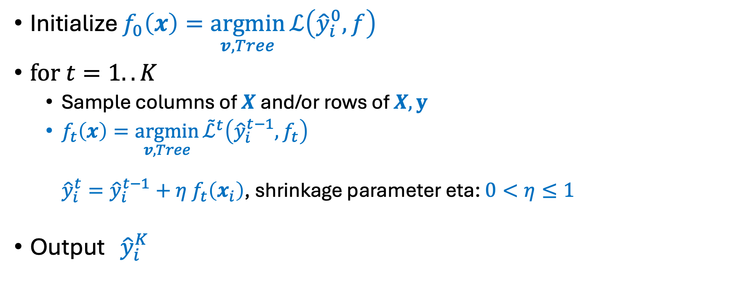
XGBoost
Markus Müller
Initialize $f_{0}\left(x\right)=\underset{v,Tree}{argmin}{ℒ\left({\hat{y}}_{i}^{0},f\right)}$
$\text{for} t=1..K$
Sample columns of $X$ and/or rows of $X, y$
$f_{t}\left(x\right)=\underset{v,Tree}{argmin}{{\tilde{ℒ}}^{t}\left({\hat{y}}_{i}^{t−1},f_{t}\right)}$ ${\hat{y}}_{i}^{t}={\hat{y}}_{i}^{t−1}+η$ $f_{t}\left(x_{i}\right)$, shrinkage parameter eta: $0<η≤1$
Output ${\hat{y}}_{i}^{K}$

Slide 19
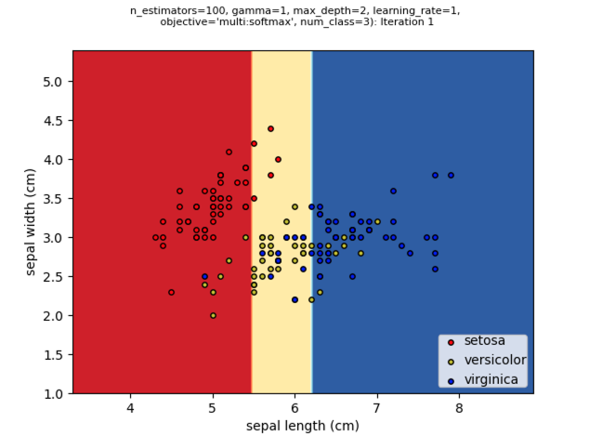
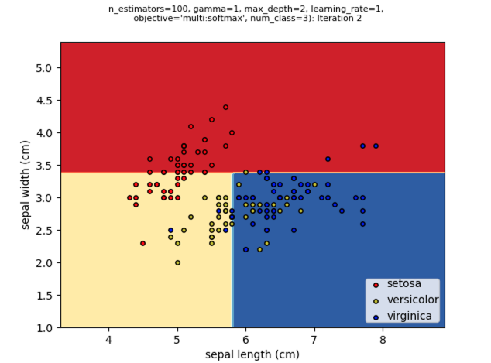
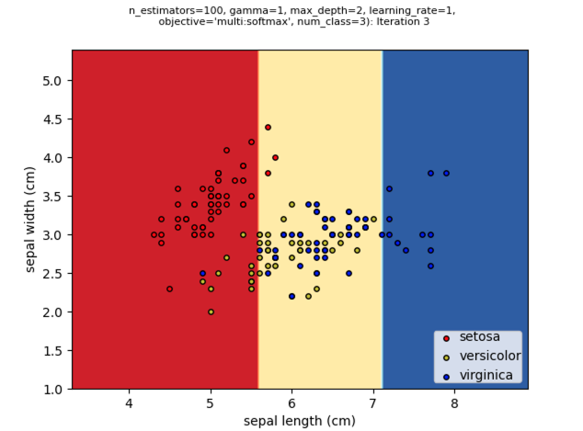
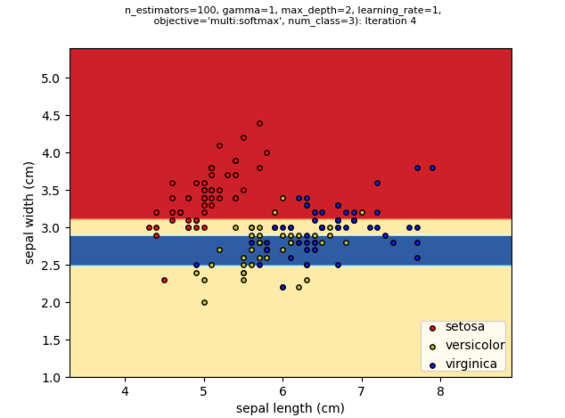
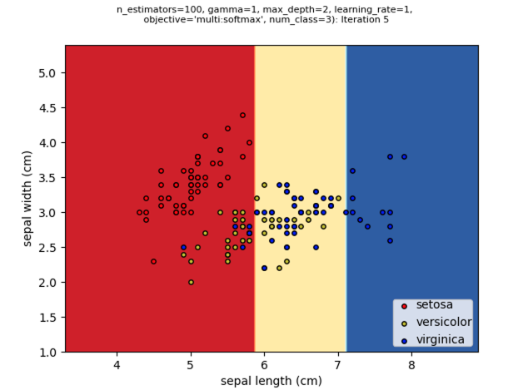
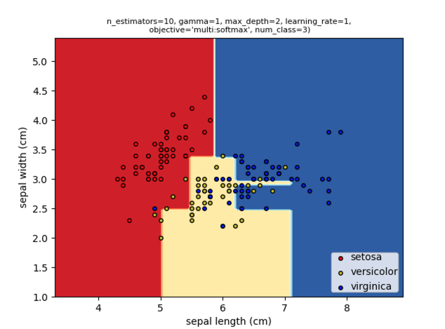
XGBoost

Slide 20
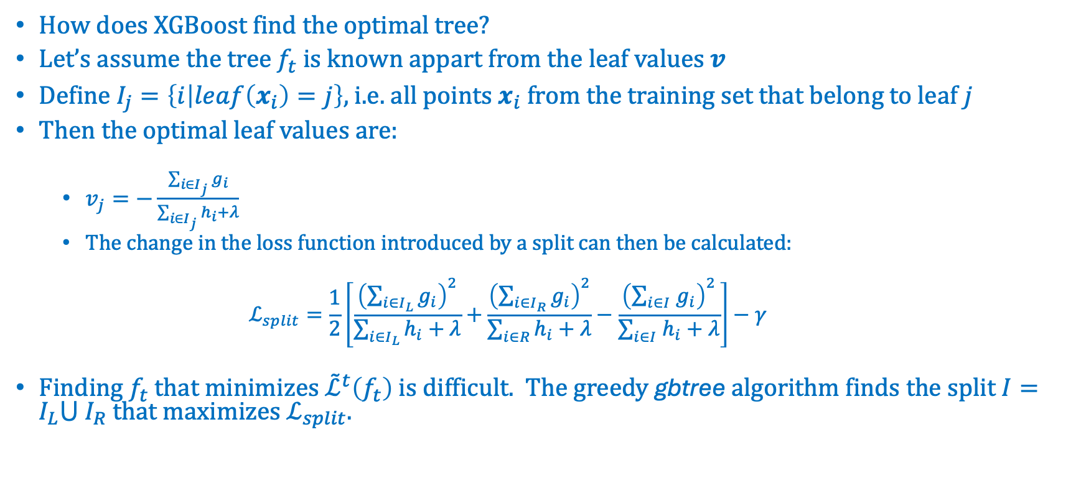
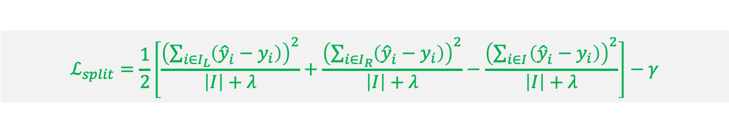
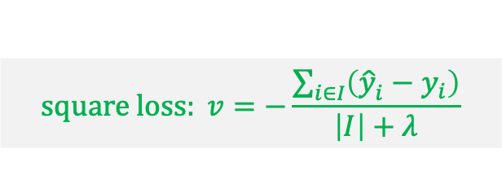
XGBoost
Markus Müller
How does XGBoost find the optimal tree?
Let’s assume the tree $f_{t}$ is known appart from the leaf values $v$
Define $I_{j}=\left\{i | leaf\left(x_{i}\right)=j\right\}$, i.e. all points $x_{i}$ from the training set that belong to leaf $j$
Then the optimal leaf values are:
$v_{j}=−\frac{\sum_{i∈I_{j}}{g_{i}}}{\sum_{i∈I_{j}}{h_{i}+λ}}$
The change in the loss function introduced by a split can then be calculated: $ℒ_{split}=\frac{1}{2}\left[\frac{{\left(\sum_{i∈I_{L}}{g_{i}}\right)}^{2}}{\sum_{i∈I_{L}}{h_{i}+λ}}+\frac{{\left(\sum_{i∈I_{R}}{g_{i}}\right)}^{2}}{\sum_{i∈R}{h_{i}+λ}}−\frac{{\left(\sum_{i∈I_{ }}{g_{i}}\right)}^{2}}{\sum_{i∈I_{ }}{h_{i}+λ}}\right]−γ$
Finding $f_{t}$ that minimizes ${\tilde{ℒ}}^{t}\left(f_{t}\right)$ is difficult. The greedy gbtree algorithm finds the split $I=I_{L}⋃$ $I_{R}$ that maximizes $ℒ_{split}$.
$$square loss: v=−\frac{\sum_{i∈I}{\left({\hat{y}}_{i}^{ }−y_{i}\right)}}{\left|I\right|+λ}$$
$$ℒ_{split}=\frac{1}{2}\left[\frac{{\left(\sum_{i∈I_{L}}{\left({\hat{y}}_{i}^{ }−y_{i}\right)}\right)}^{2}}{\left|I\right|+λ}+\frac{{\left(\sum_{i∈I_{R}}{\left({\hat{y}}_{i}^{ }−y_{i}\right)}\right)}^{2}}{\left|I\right|+λ}−\frac{{\left(\sum_{i∈I_{ }}{\left({\hat{y}}_{i}^{ }−y_{i}\right)}\right)}^{2}}{\left|I\right|+λ}\right]−γ$$

Slide 21
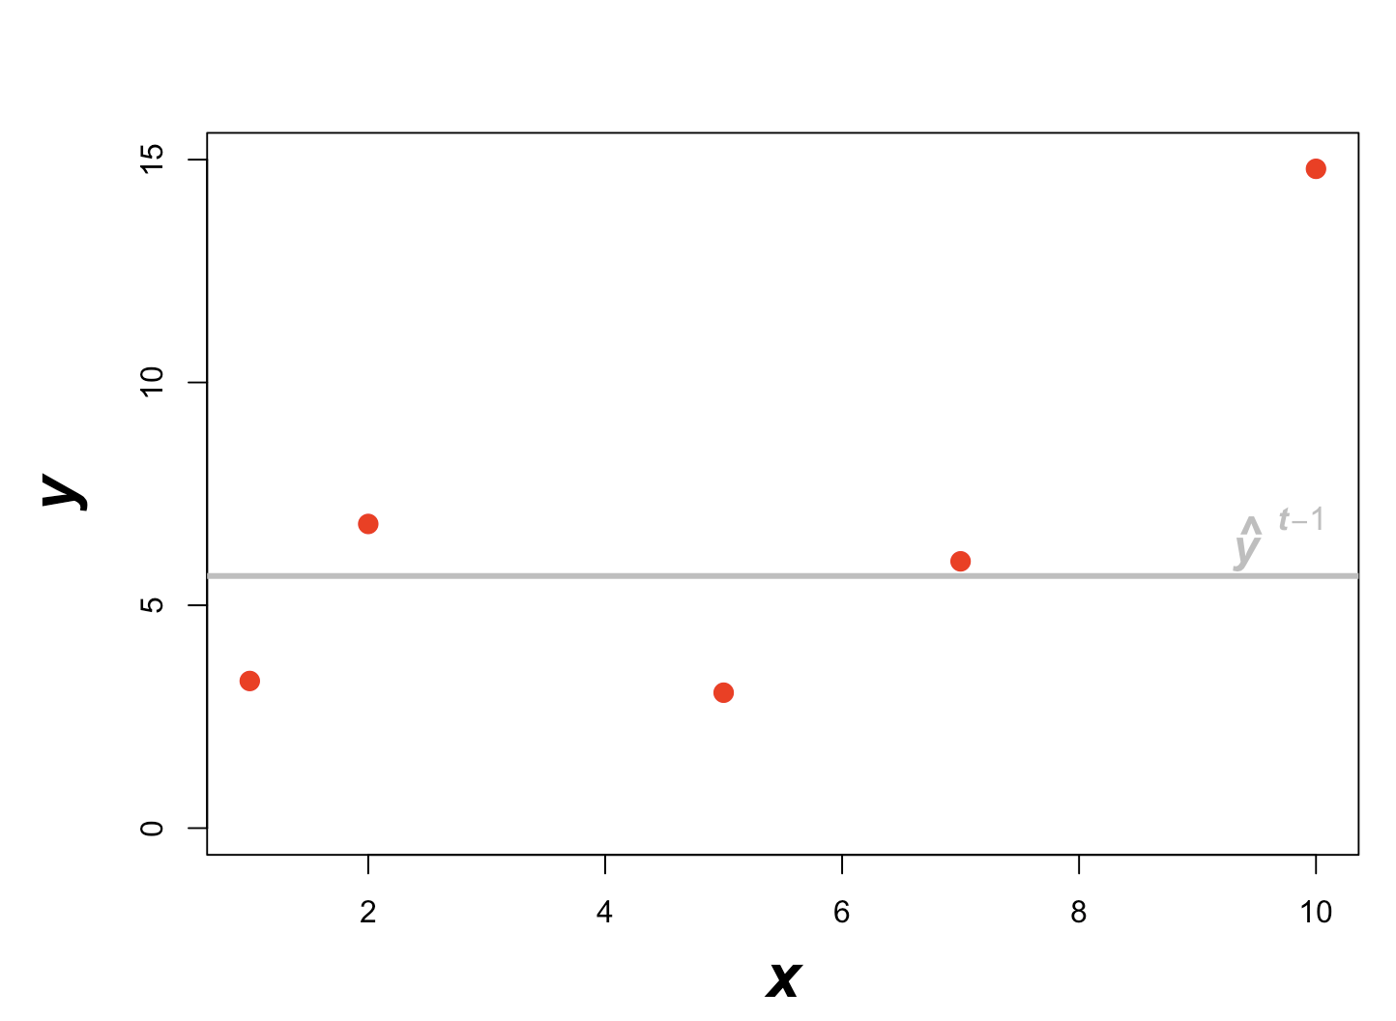
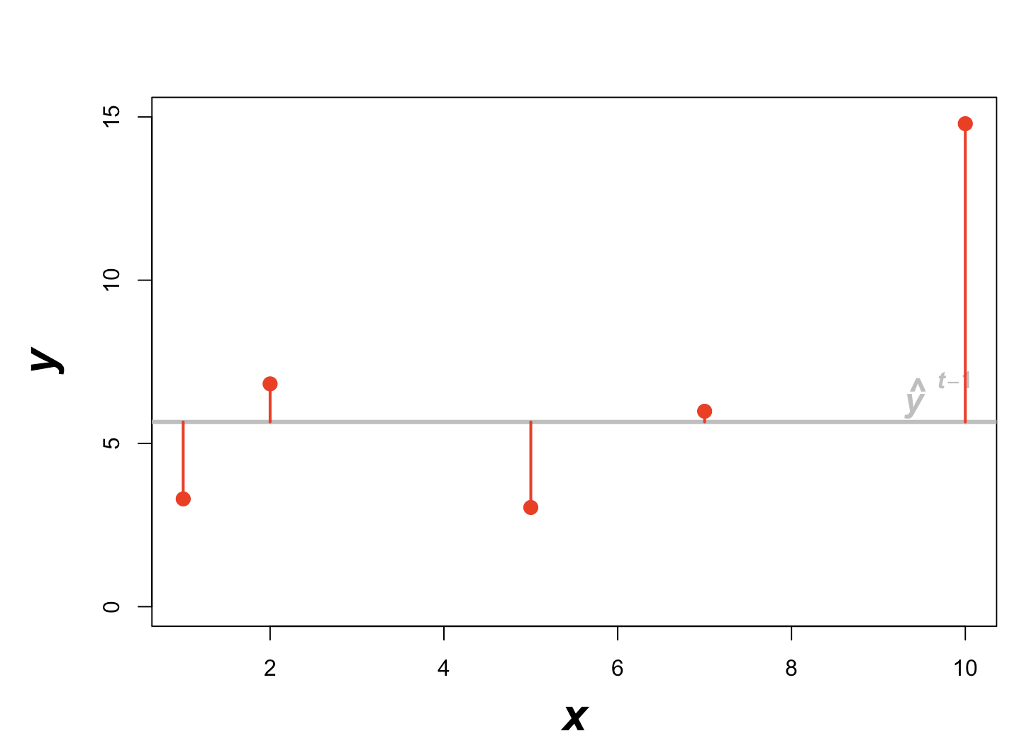
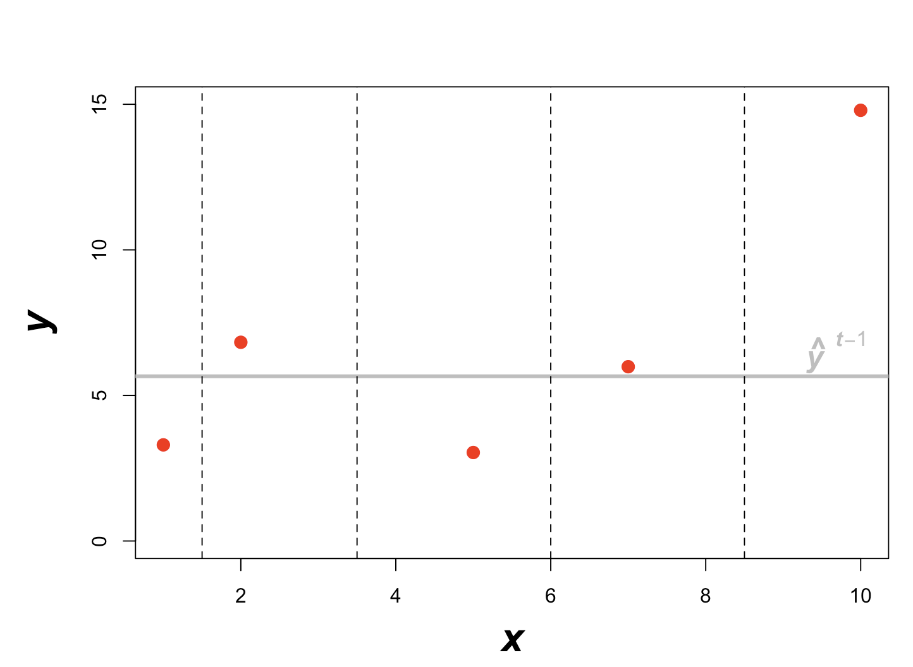
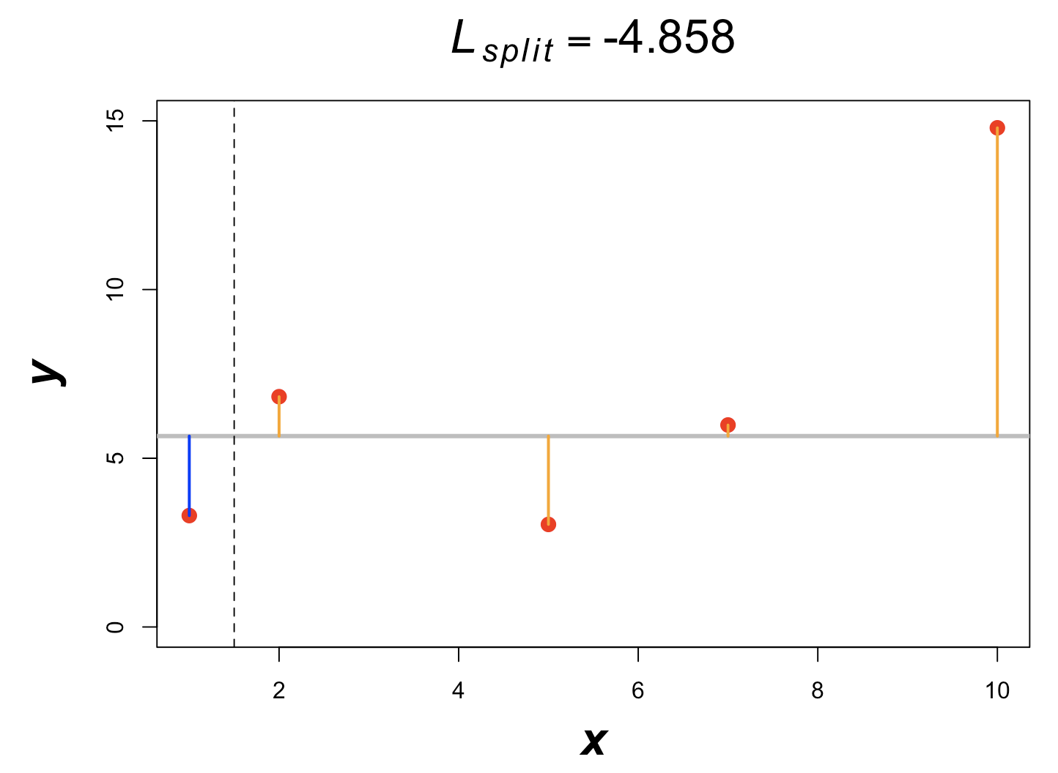
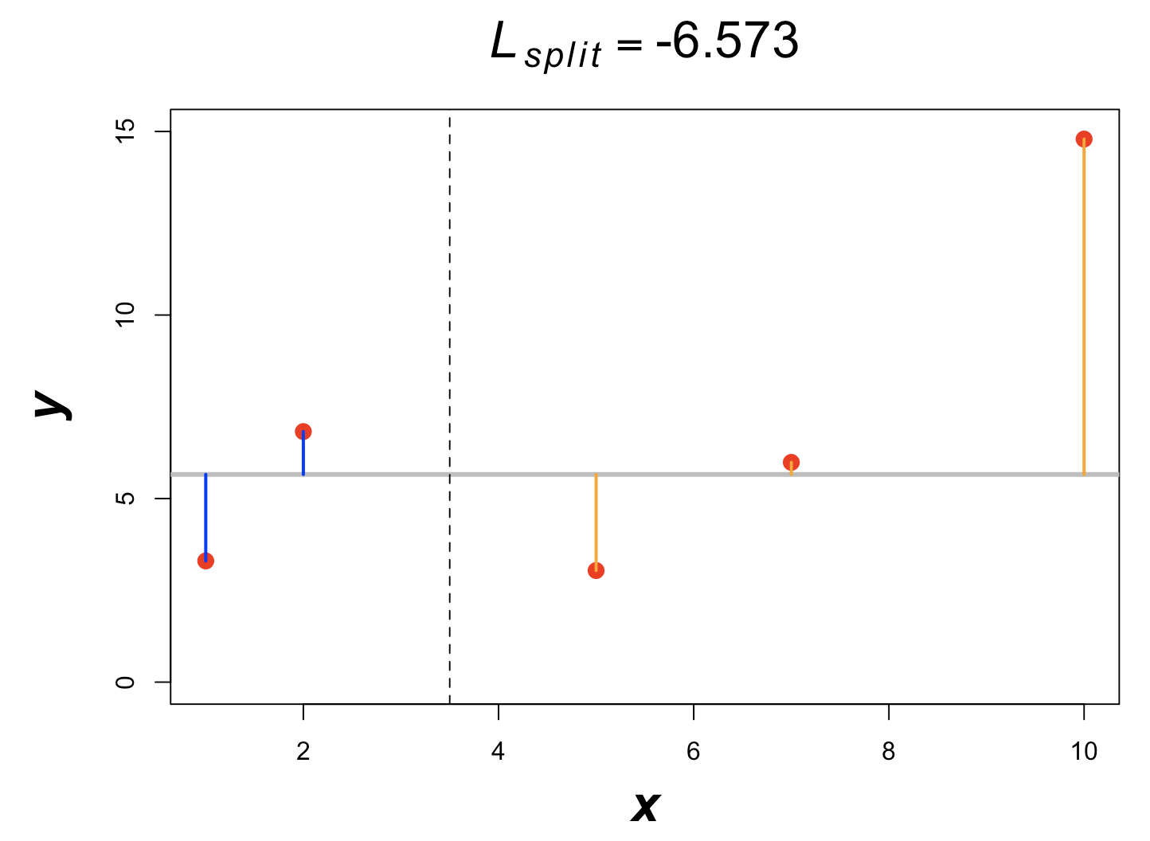
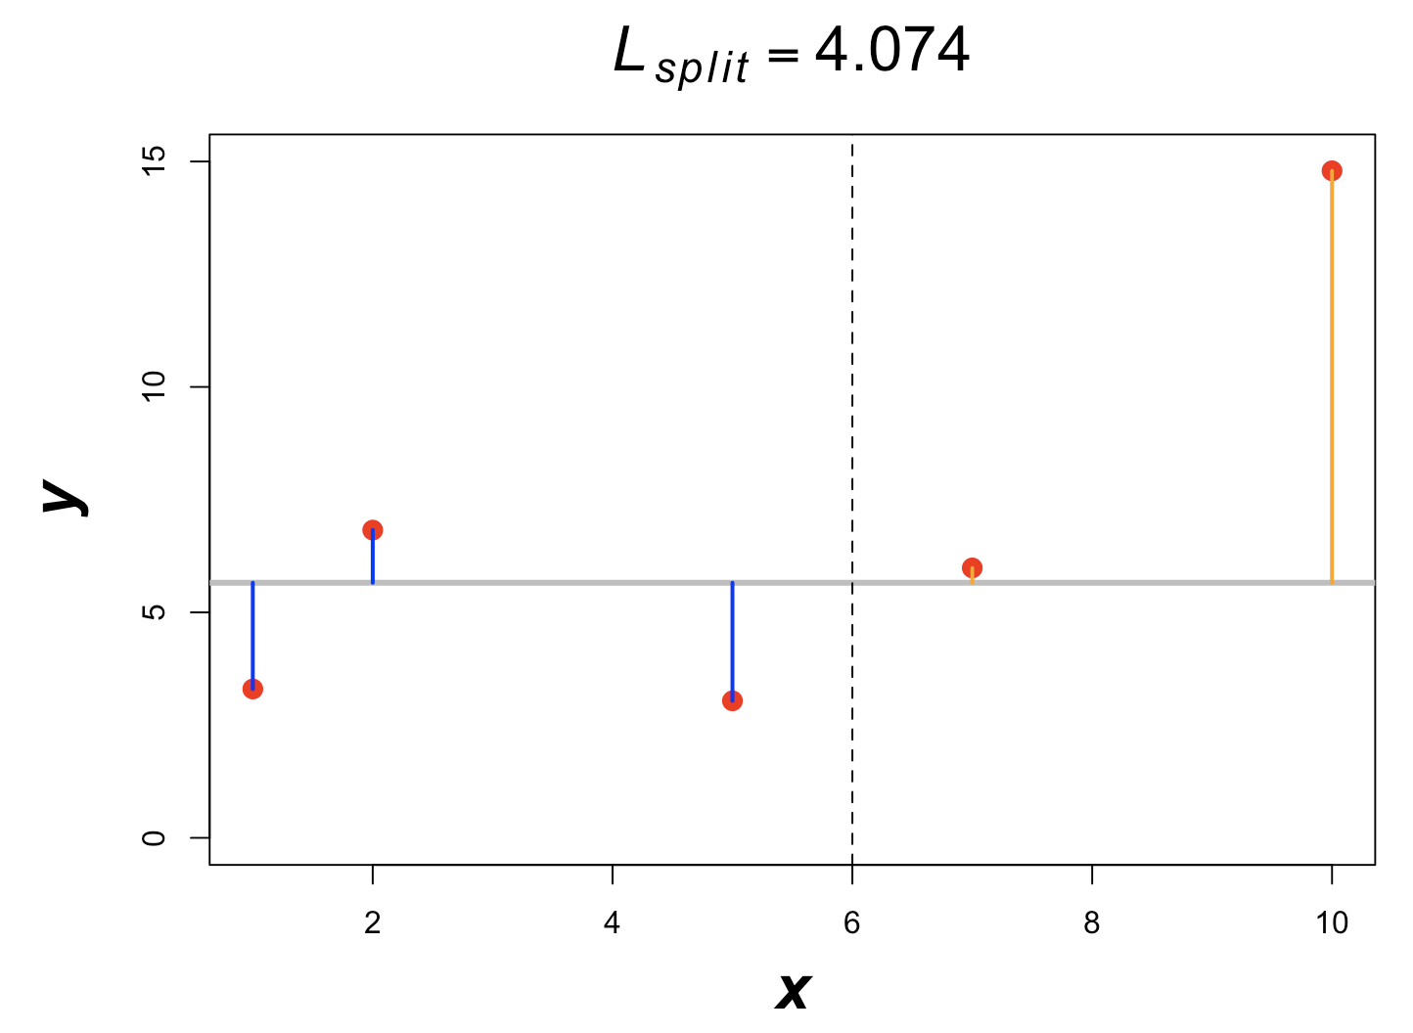
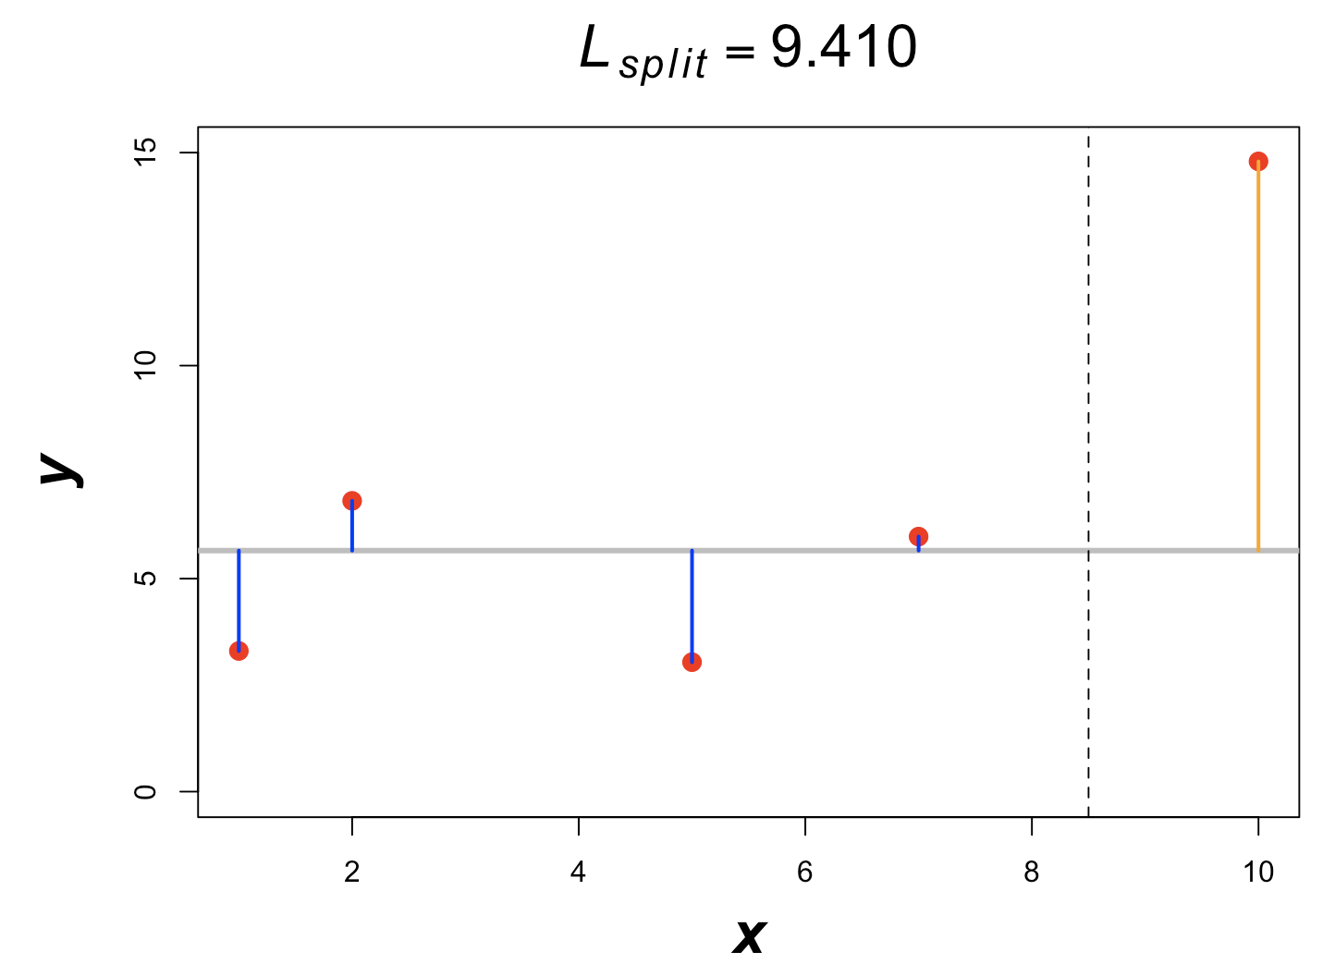
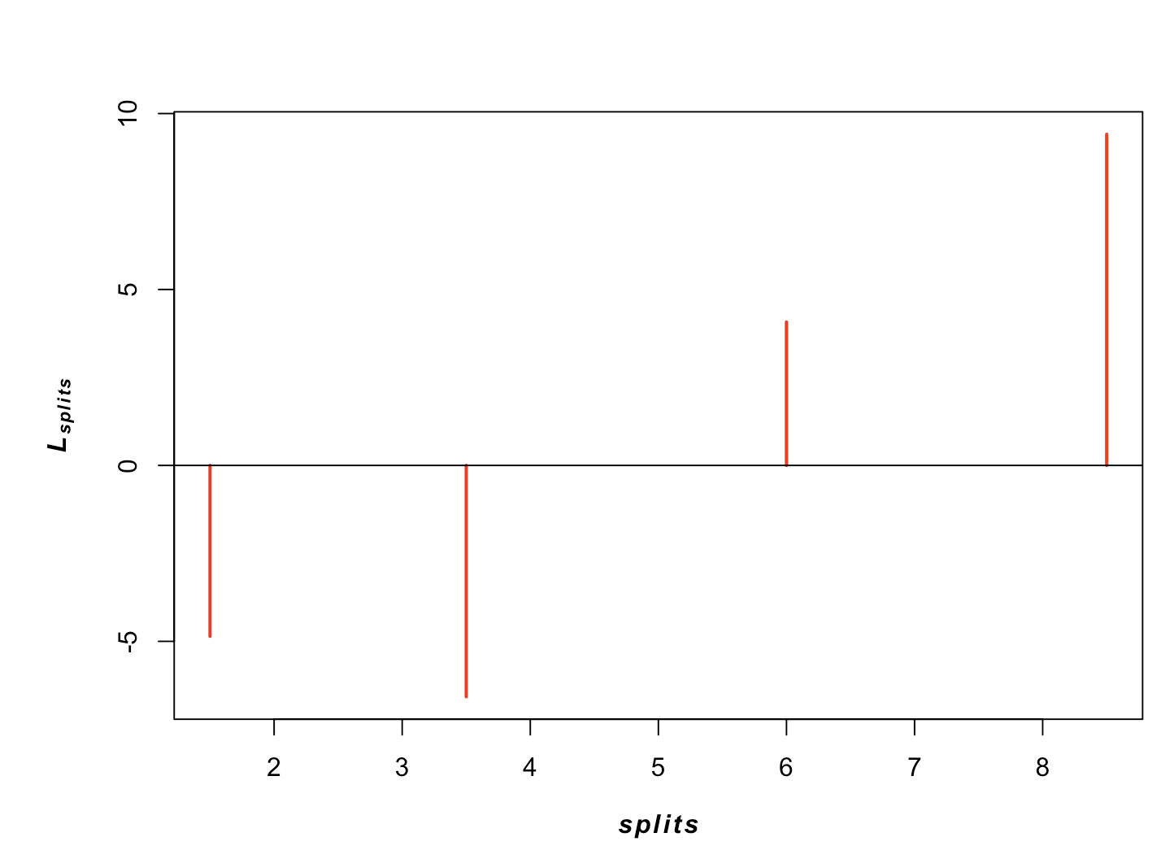
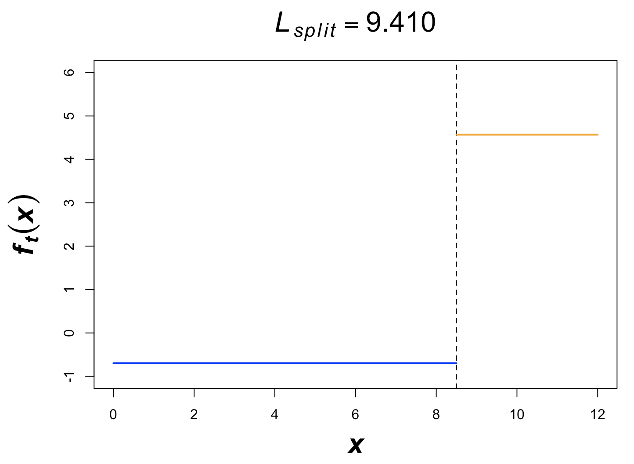
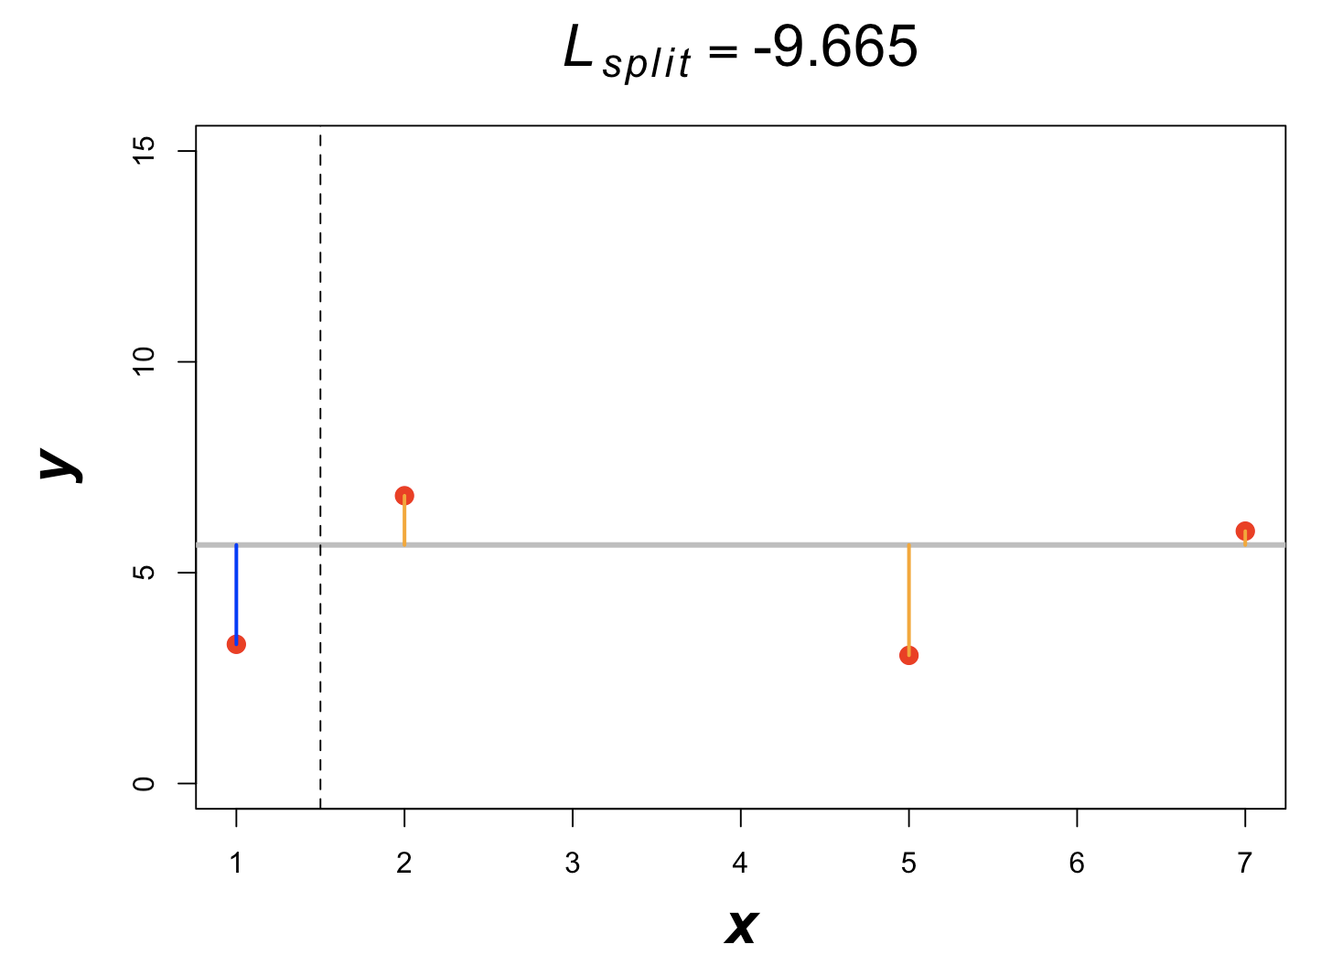
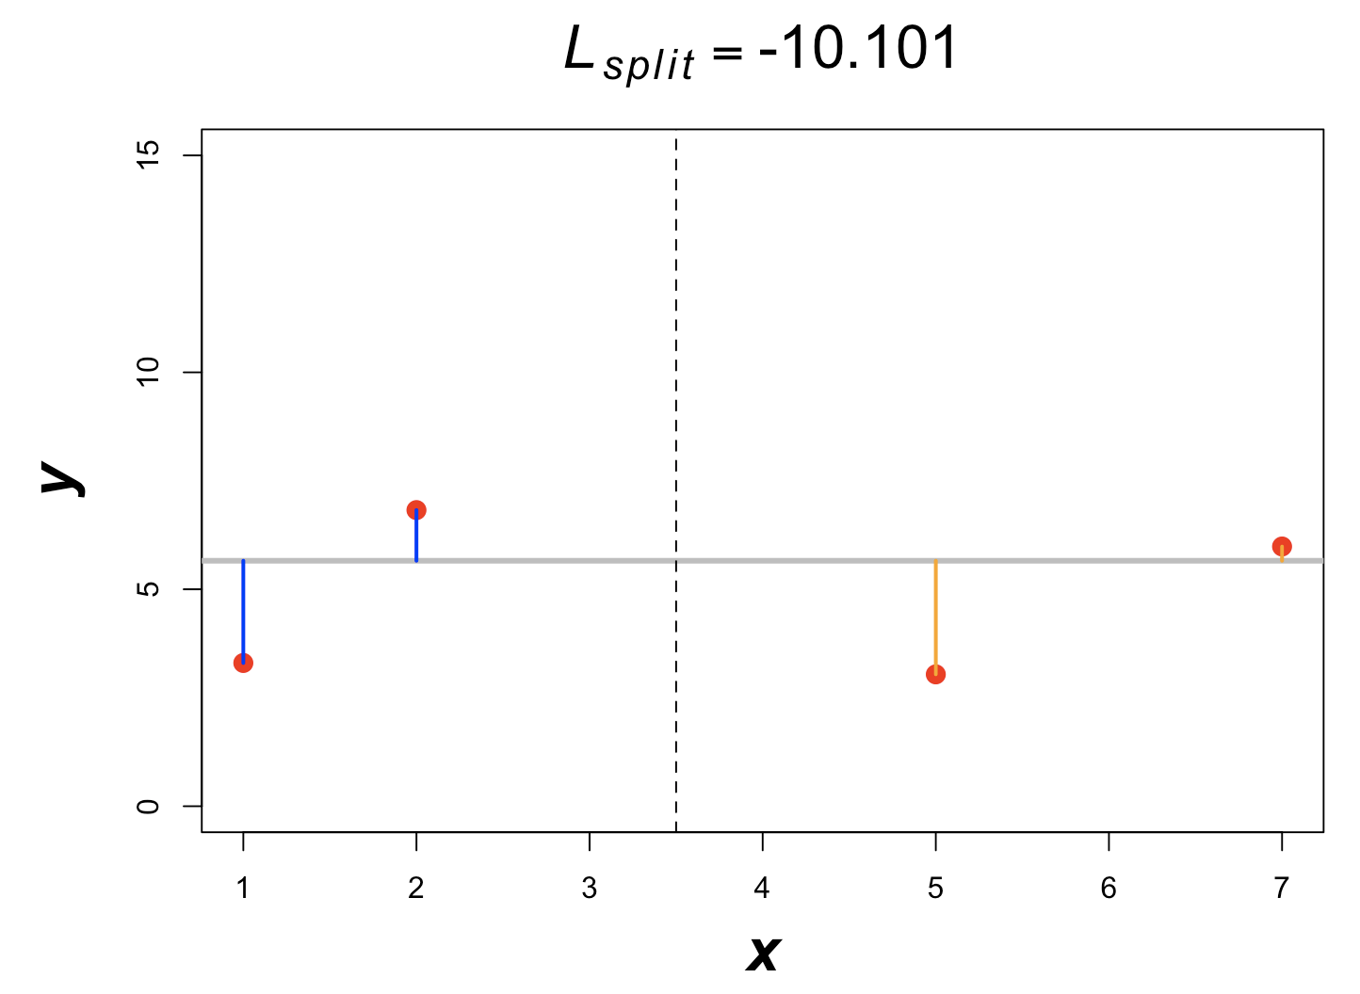
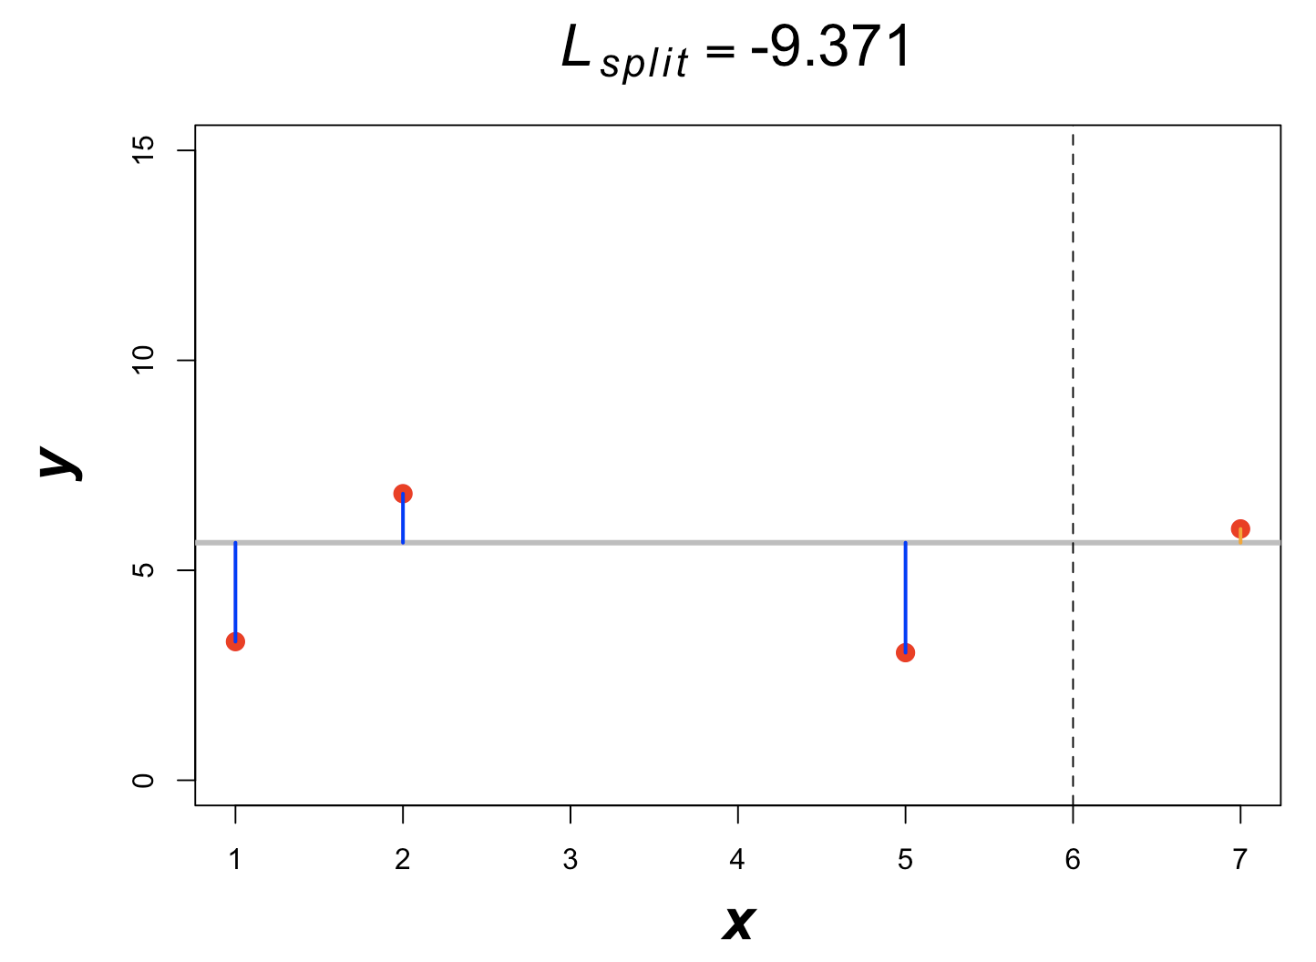
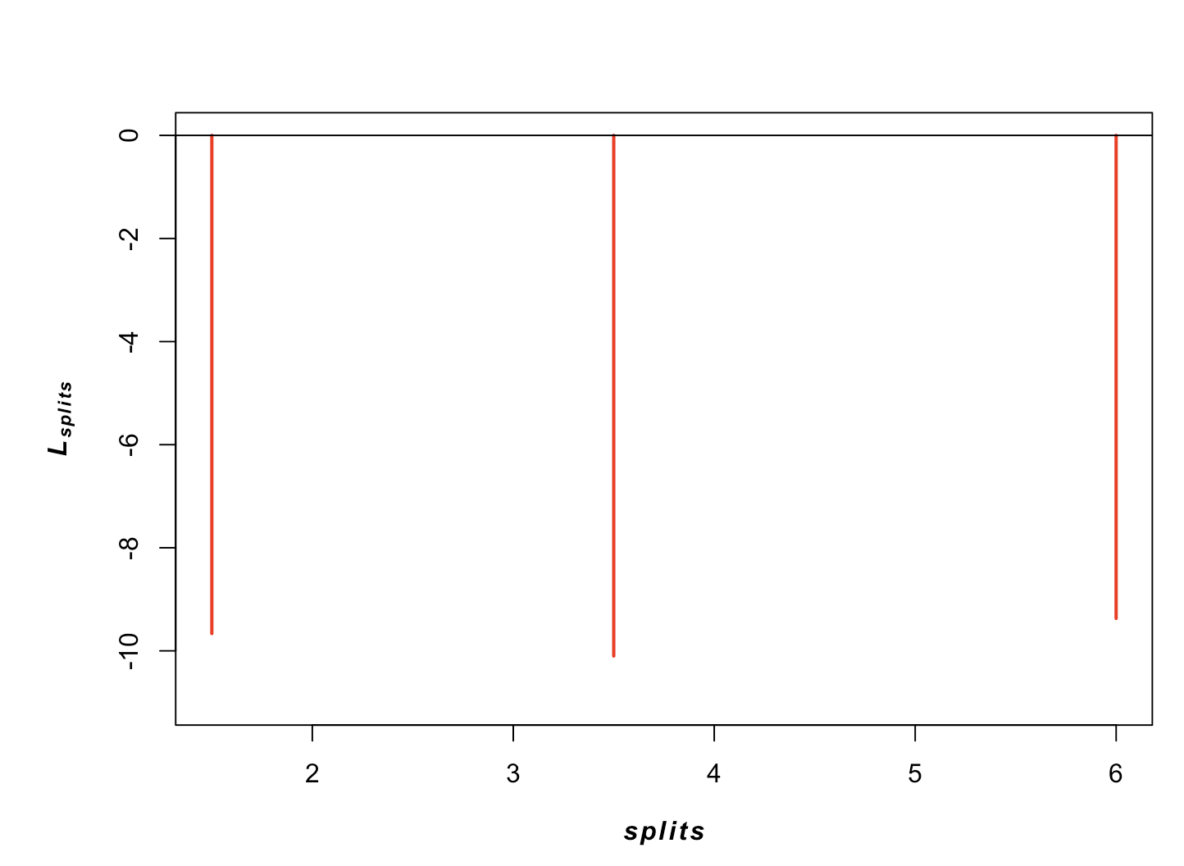










XGBoost
$$x<8.5$$
$$I=\left\{1,2,3,4,5\right\}$$
$$ν=5.10$$
$$ν=9.31$$
$$I=\left\{1,2,3,4\right\}$$
$$I=\left\{5\right\}$$
$$η=0.8; λ=1;γ=10$$
$$v=−\frac{\sum_{i∈I}{\left({\hat{y}}_{i}^{ }−y_{i}\right)}}{\left|I\right|+λ}$$
$$ℒ_{split}=\frac{1}{2}\left[\frac{{\left(\sum_{i∈I_{L}}{\left({\hat{y}}_{i}^{ }−y_{i}\right)}\right)}^{2}}{\left|I\right|+λ}+\frac{{\left(\sum_{i∈I_{R}}{\left({\hat{y}}_{i}^{ }−y_{i}\right)}\right)}^{2}}{\left|I\right|+λ}−\frac{{\left(\sum_{i∈I_{ }}{\left({\hat{y}}_{i}^{ }−y_{i}\right)}\right)}^{2}}{\left|I\right|+λ}\right]−γ$$

Slide 22

XGBoost – Approximate algo and missing values
Instead of testing each value of a numeric feature as a potential threshold, XGBoost has an approximate histogram-based algorithm, which only allows splits at certain percentiles.
Each interval contains datapoints $x_{i}$ with a similar sum of hessian $h_{i}$
In case of missing values, XGBoost calculates a default direction for each node. The default direction gives the largest gain $ℒ_{split}$ if all missing values are assigned to this direction.

Slide 23

XGBoost Hyperparameters
Markus Müller
booster: base model (gbtree, dart or gblinear)
device: GPU or CPU
eta: step size shrinkage ($η$)
gamma: minimum loss reduction required to make a further partition on a leaf node ($γ$)
max_depth: maximum depth of a tree
min_child_weight: minimum sum of instance weight needed in a child
subsample: subsample ratio of the training instances
colsample_bytree, colsample_bylevel, colsample_bynode: parameters for subsampling of columns
lambda: L2 regularization term on weights
tree_method: The tree construction algorithm
scale_pos_weight: useful for unbalanced classes
process_type: used to update existing model
max_leaves: maximum number of leaves
monotone_constraints: constraint of variable monotonicity
interaction_constraints: constraints for interaction representing permitted interactions
objective: loss function
eval_metric: evaluation metrics for validation data
max_cat_to_onehot: how to deal with categorical features

Slide 24

XGBoost +/-
Markus Müller
When to use XGBoost
Classification and regression problems
Categorical variables
Missing values
Tabular data with heterogeneous features
Very flexible and comprehensive API
Applicable to large data
…
When not to use XGBoost
$n>N$, i.e. more features than observations
Regression tasks, where output needs to be continuous
Extrapolation tasks
For image and language processing NN are preferred
Other excellent gradient boosting tools are LightGBM, CatBoost,..
Notes:
LightGBM: Microsoft
CatBoost: Yandex

Slide 25
Hyperparameter optimization
Markus Müller
ML models have internal parameters, which are learned by the training algorithm, and hyperparameters, which have to be set before training.
Both internal - and hyperparameters have a strong impact on the performance of the ML model.
There is a tradeoff between CPU/GPU cycles spent on hyperparameter optimization and training. Allocating more cycles for hyperparameter optimization can be more rewarding.
Hyperparameter optimization is implemented as an outer loop over the CV loop

Slide 26

Hyperparameter optimization and CV
Markus Müller
Hyperparameter space $Φ$
Dataset $X$, Labels $y$
Number of iterations $M$
Number of CV folds $F$
$S_{max}=−∞$, $φ_{max}=None$
for $i=1,..,M$ :
$$φ=choose\left(Φ\right)$$
for $j=1,..,F$ :
$X_{train},$ $X_{test},y_{train}, y_{test}=split\left(X,j\right)$
${C_{φ,θ}=𝒞}_{φ}$.train$\left(X_{train}\right)$
$S_{j}=S\left(C_{φ,θ}.\text{predict}\left(X_{test}\right),y_{test}\right)$
$\overline{S}=\frac{1}{F}\sum_{j=1}^{F}{S_{j}}$
if $\overline{S}>S_{max}$: $S_{max}=\overline{S}$, $φ_{max}=$ $φ$
Hyperparameter
search loop
CV loop

Slide 27
Hyperopt
Markus Müller
Random algorithms find optimal solutions faster and more accurately than grid searches
Therefore Hyperopt implements a random search algorithm.
Hyperopt also offers two other model-based search algorithms:
Gaussian process approach (GP) (not implemented in python)
Tree-structured Parzen window approach (TPE)
Hyperopt supports nested parameter spaces
Hyperopt supports warm start using previous results

Slide 28

Hyperopt’s model-based algorithm
Markus Müller

Slide 29









Hyperopt’s TPE algorithm
Markus Müller
$$l\left(x\right)$$
g$\left(x\right)$
g$\left(x\right)$
$$y^{∗}$$
$$l\left(x\right)$$
The TPE algorithm will choose hyperscores with large $l\left(x\right)$ and small $g\left(x\right)$.
TPE: Tree structured Parzen estimator
$$y^{∗}=γ−\text{quantile}:p\left(y<y^{∗}\right)=γ$$

Slide 30

Nested Cross-Validation (CV)
Markus Müller
Issues that may arise with CV:
Let’s assume you perform a hyperparameter optimization for a classifier with CV. In each iteration, you keep the maximal score $S_{max}$. Even if all scores are drawn from Null distribution, this will lead to a final score $S_{max}$that is significantly higher than the expected score.
We strongly discourage ML practitioners to perform any operation that uses information from test or validation data (such as feature selection, MV imputation, normalization) for data preprocessing pefore the CV loop. In the CV loop, this data leakage will lead to $S_{max}$ that are too high, especially for small sample sizes.
Solution: always calculate your score $S$ on a part of the data that was not used for proprocessing.

Slide 31
Interpretable Machine Learning (IML)
Markus Müller
ML tools are optimized for metrics such as accuracy, which can lead to accurate, but wrong models.
Many models are black boxes, i.e. they do not reveal in a human readable form how they make their decision.
In order to understand a model, we need to approximate the model’s decision with a simple human readable model.
If this simple approximation corresponds to human intuition and knowledge and is faithful (i.e. truly reflects the underlying ML model), we can better trust the ML model.

Slide 32


Interpretable Machine Learning (IML)
Markus Müller
Ribeiro et al., ACM SIGKDD, 2016

Slide 33

Interpretable Machine Learning (IML)
Markus Müller
Chen et al, Nature Methods, 2024

Slide 34
IML Guidelines
Markus Müller
Use several IML methods and compare the results
Use several datasets if possible, or randomly sample from your data, to show that your results are robust.
Use different hyperparameter choices for the underlying model. Use more than one model.
Evaluate the plausibility and faithfulness of the IML interpretation:
Do they agree with prior or expert knowledge?
Do they represent the model’s reasoning process?
Avoid cherry-picking nice examples, but always report full results.

Slide 35

IML
Markus Müller
Local interpretation:
An interpretation is calculated for a single data vector $x$.
A local interpretation tells you, how a specific data vector $x$ was predicted by the ML model. It tells you which features are predominantly involved in the prediction.
Global interpretation:
An interpretation is calculated on a whole data set $\left\{x_{k}\right\}, k=1,..,N$
The global interpretation tells you, which features are predominantly involved in the prediction of a whole dataset.
A global interpretation can be obtained by averaging over local interpretations.

Slide 36
LIME
Markus Müller
LIME: Local Interpretable Model-Agnostic Explanations
Approximates any ML model by a simple local model
Provides control over the complexity of the local model
Provides global interpretation of the ML model

Slide 37


LIME: local interpretation
Markus Müller
$$ξ\left(x\right)=\underset{g∈G}{argmin}{ℒ\left(f,g,π_{x}\right)+Ω\left(g\right)}$$

Slide 38

Shapley Values
Markus Müller
Developed by economics Noble prize winner Loyd Shapley in 1951 (Shapley )
How do you evaluate the importance of a single player in a team of $n$ players $𝒩$?
Let’s assume the outcome of the game is measured by a score $f$. E.g. $f$ might be the percentage of games won, or the probability of a classifier.
If only a subset $S⊂𝒩$of all players takes part in the game, the score is $f\left(S\right)$
Idea: the importance of a player is evaluated relative to all subsets of players $S$.

Slide 39





Shapley Values
Markus Müller
The Shapley value $φ_{i}$ of player $i$ is defined by: $φ_{i}\left(f\right)=\sum_{S⊂𝒩/{\left\{i\right\}}}{\frac{\left|S\right|!\left(n−\left|S\right|−1\right)!}{n!}}\left(f\left(S∪\left\{i\right\}\right)−f\left(S\right)\right)$
W$eight of S$
Gain in $v$ by including player $i$ in $S$
Sum over all subsets $S$

Slide 40

Shapley Values for ML
Markus Müller
Let’s assume we have a trained ML model, which predicts the output $f\left(x_{j}\right)$ of a vector $x_{j}=\left(x_{j1},..,x_{jn}\right)∈ℝ^{n}$ from our dataset $𝒟=\left\{x_{j}\right\},1≤j≤N$
$S⊂$ $𝒩=\left\{1,..,n\right\}$. How do we define $f\left(x,S∪\left\{i\right\}\right)−f\left(x,S\right)$?
Define mask: $x_{S}\left(x, y\right)≡\left\{\begin{matrix}x_{i} \text{for} i∈S \\ y_{i} \text{for} i∉S\end{matrix}\right.$
$$f\left(x,S\right)=E_{x_{𝒩\backslash S}}\left(f\left(x\right)\right)=\sum_{y∈𝒟}{\left[f\left(x_{S}\left(x, y\right)\right)−f\left(y\right)\right]}$$
$$φ_{i}\left(x\right)=\sum_{S⊂𝒩/{\left\{i\right\}}}{\frac{\left|S\right|!\left(n−\left|S\right|−1\right)!}{n!}}\left(f\left(x,S∪\left\{i\right\}\right)−f\left(x,S\right)\right)$$
$\sum_{i=1}^{n}{φ_{i}\left(x\right)}=f\left(x\right)−E_{x_{ }}\left(f\left(x\right)\right)$

Slide 41



IML with Shapley values
Markus Müller
Good prediction
Bad prediction
Notes:
SHAP (SHapley Additive exPlanation) values explain the output of a function f as a sum of the effects φi of each
feature being introduced into a conditional expectation. Importantly, for non-linear functions the order in which features
are introduced matters. SHAP values result from averaging over all possible orderings. Proofs from game theory show this is
the only possible consistent approach where 􏰀M φi = f (x). In contrast, the only current individualized feature attribution i=0
method for trees satisfies the summation, but is inconsistent because it only considers a single ordering [24].
local accuracy, missingness, and consistency. Local accuracy states that the sum of the feature attributions is equal to the output of the function we are seeking to explain. Missingness states that features that are already missing (such that zi′ = 0) are attributed no importance. Consistency states that changing a model so a feature has a larger impact on the model will never decrease the attribution assigned to that feature.

